Slide 1
Customized VPC

Slide 2
VPC Creation
Sign in to the AWS Management console.
Click on the VPC service under Networking & Content Delivery.
Click on the Your VPCs.
Click on the Create VPC to create own custom VPC.
Fill the details to create a custom VPC(As shown below picture).
Name Tag: It is the name of VPC.
IPv4 CIDR block: we make this address block as big as possible(192.168.0.0/16).
The below figure shows that VPC has been created.

Slide 3
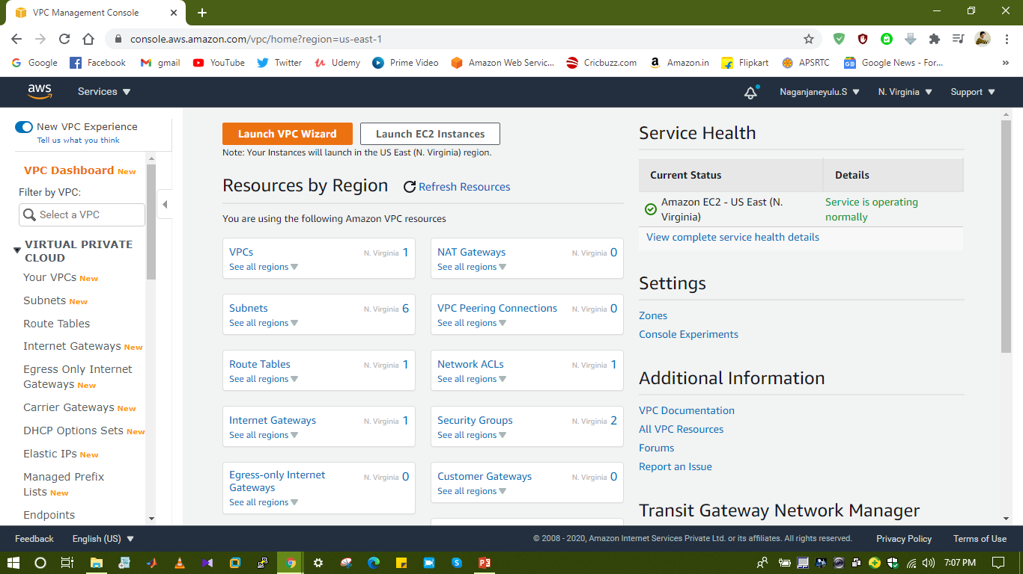
VPC Dashboard

Slide 4
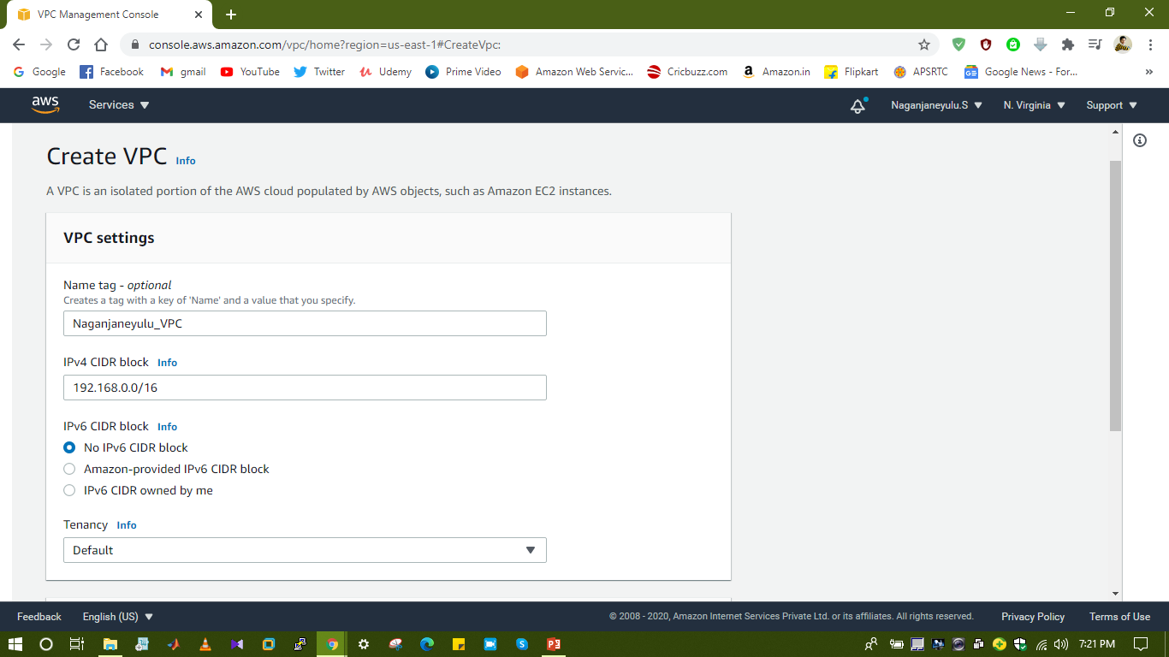
Create VPC

Slide 5
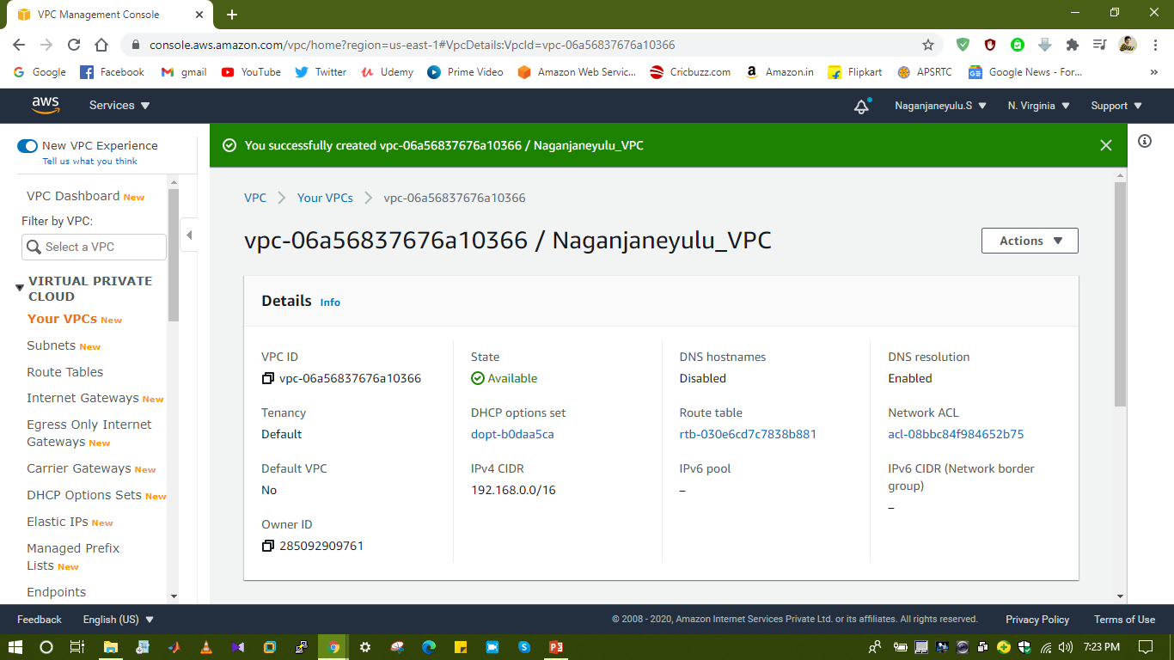

Slide 6
After creation VPC
By default It will create automatically Route table, NACL and Security group.
We need create subnets.
Enter the details to create a subnets(Picture as shown below).
To make subnet public, click on Actions then click on Modify auto assign IP settings.
We need create Route tables ,click on Route tables and create route table.
We need explicit subnet association, edit routs on public subnets and attach IGW.(before attaching IGW we need to create IGW)
We need create Internet Gateway ,Click on the Internet Gateways and then create(Picture as shown below).
We need to attach IGW to VPC, click on Actions click on the Attach VPC.

Slide 7
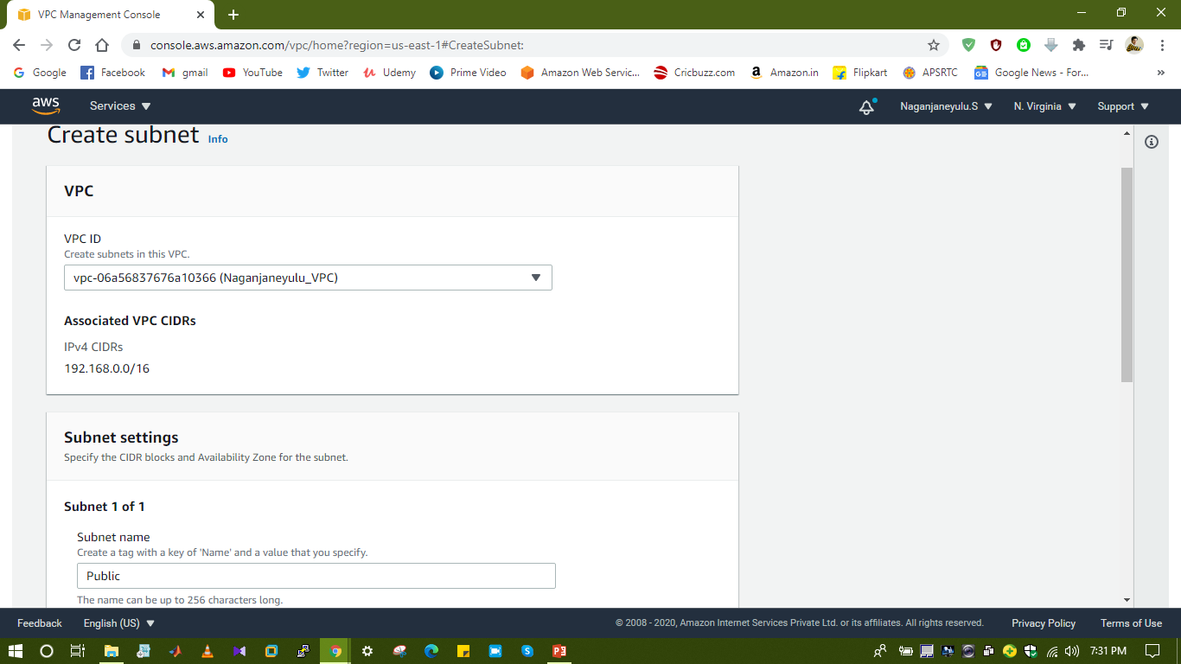
Create Subnets

Slide 8
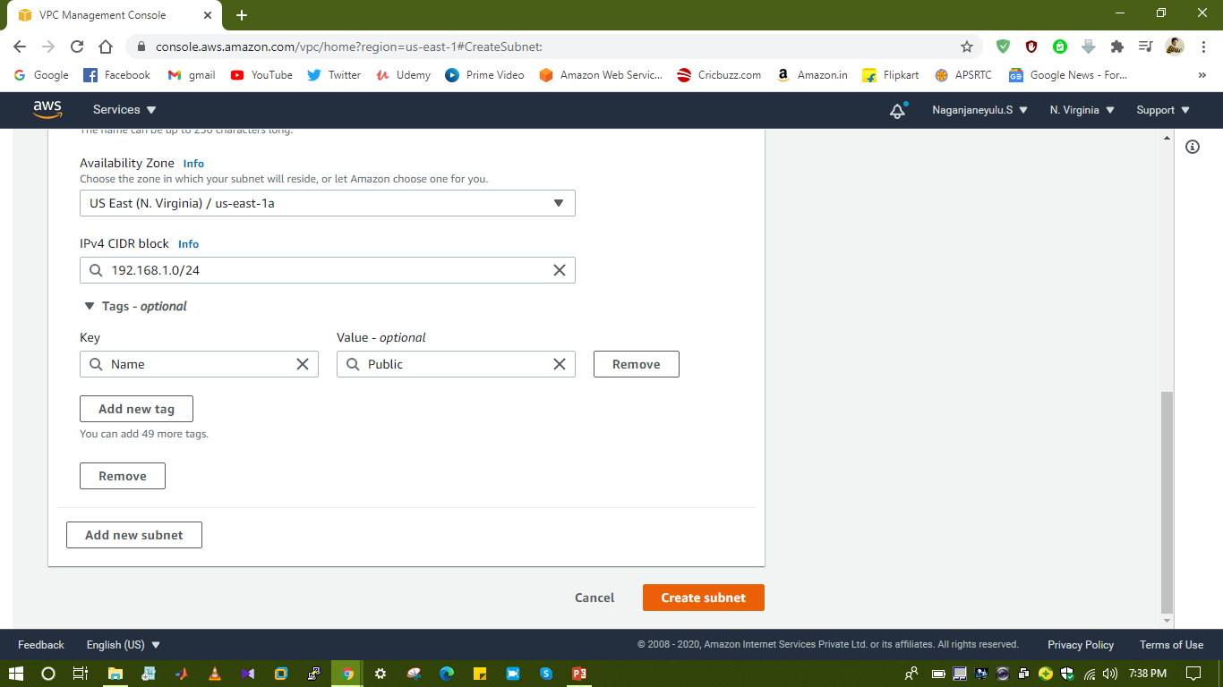

Slide 9
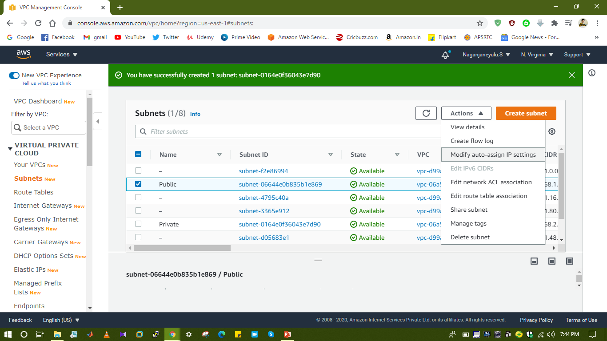
Make Subnet Public

Slide 10
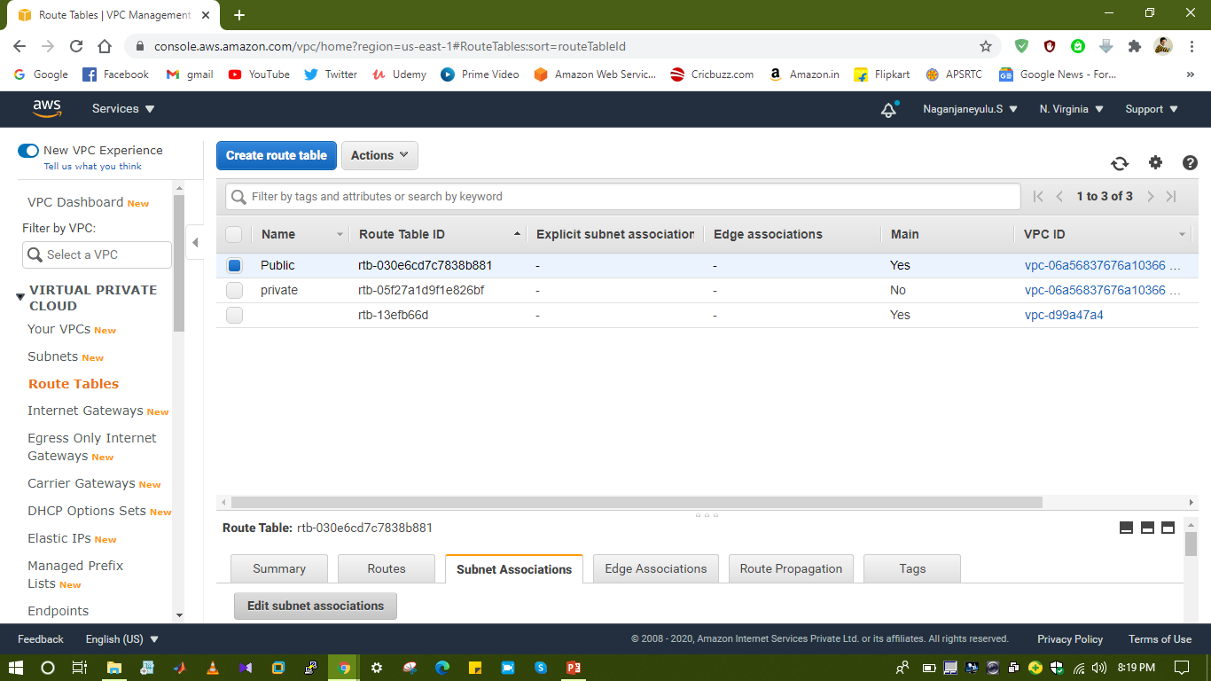
Route tables

Slide 11
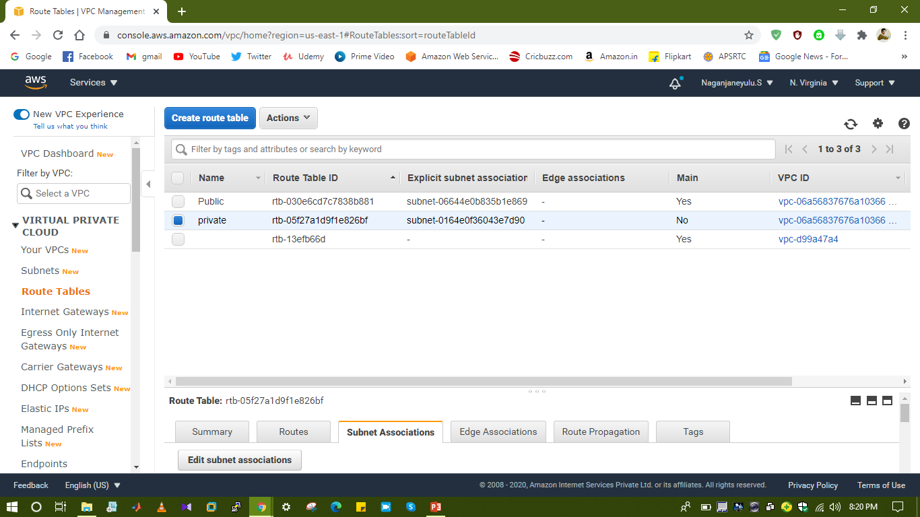
Subnet Associations

Slide 12
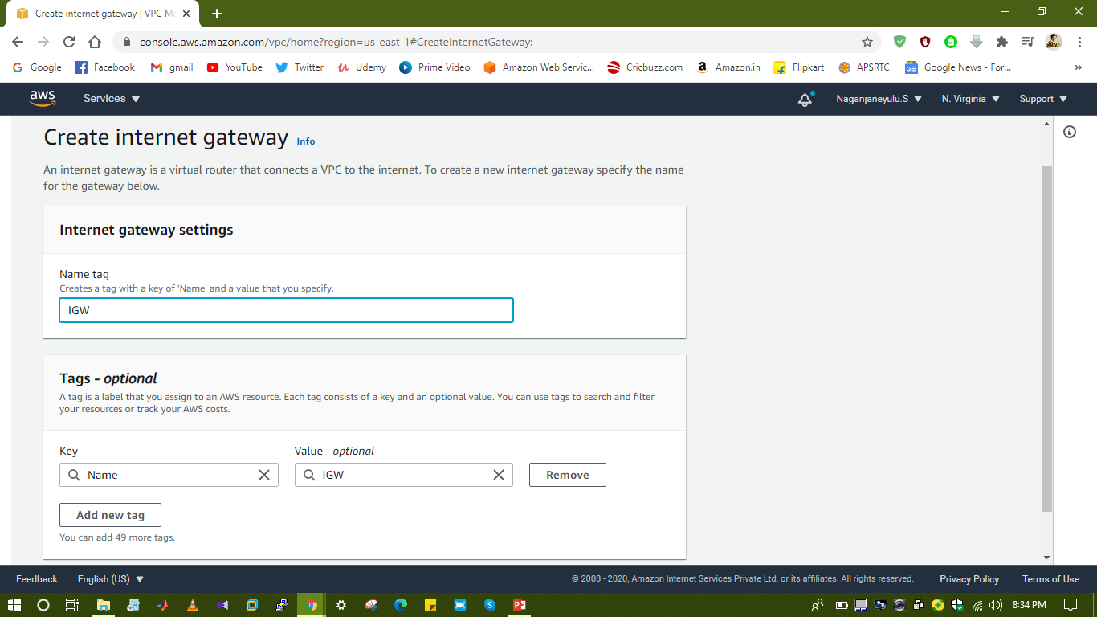
Create Internet Gateway

Slide 13
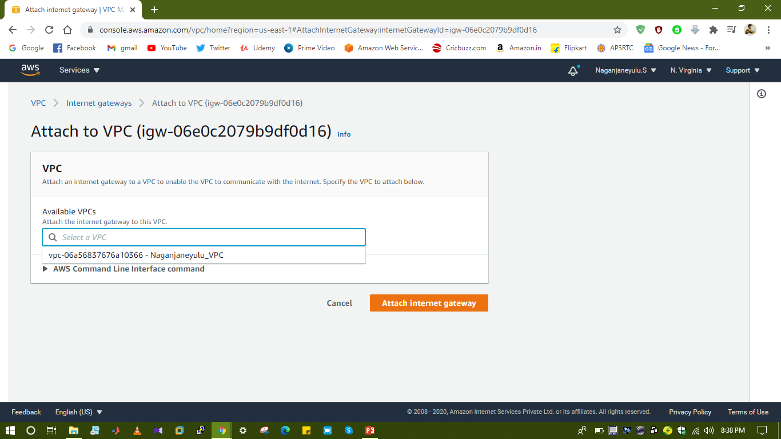
Attaching IGW to VPC

Slide 14
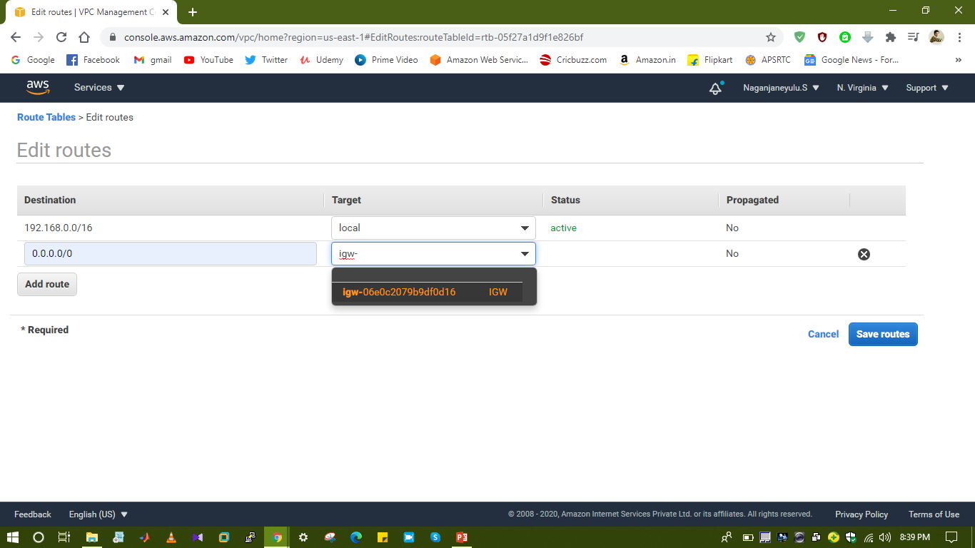
Adding IGW to Public Route

Slide 15
After VPC setup we can run Instances.
Once delete VPC all services will terminated.
We can attach only one IGW per VPC.

